Slide 1
Project2_Sales performance Analysis

Slide 2
Using Superstore dataset, created a bullet chart with Category and Segment dimensions and Sales measures. Blend the data with the Saved Sample — Sales Target data set to bring in the Sales Target measure. Color code the chart to identify Categories and Segments that are above or below target has been made. Added the year of sales to the view to identify trends and outliers. Added a filter so that the user can select one, more than one, or all years.
Calculation used here, Color code the chart to identify Categories and Segments that are above or below target.
IF SUM([Sales])> SUM([Sales Target (Sales_Target)].[Sales Target (Sales Target)]) THEN ‘Above target’ ELSE ‘Below target’ END
From this analysis we can observe there are many products whose sales are less than sales targets.

Slide 3
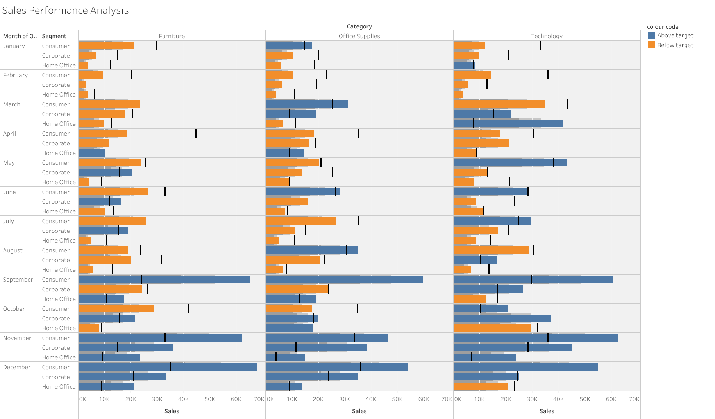

Slide 4
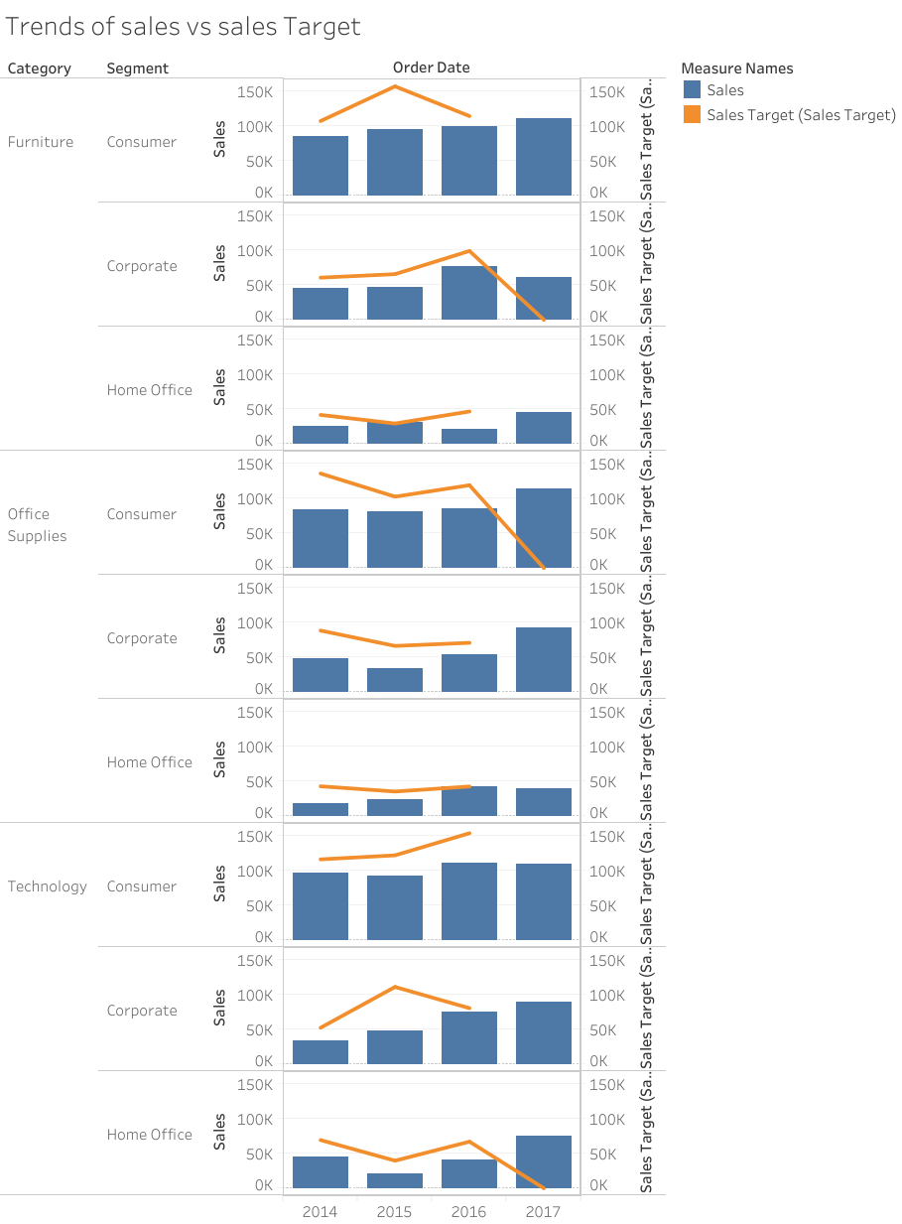
Created a trend chart to show the performance of sales and sales targets in each year according to each category and segment

